Slide 1




Class
Of
2033

Slide 2



WELCOME TO
PEARL JUNIOR HIGH SCHOOL
THE MISSION OF PEARL PUBLIC SCHOOL DISTRICT IS TO PREPARE EACH STUDENT TO BECOME A LIFELONG LEARNER, ACHIEVE INDIVIDUAL GOALS, AND POSITIVELY IMPACT A GLOBAL SOCIETY.
DOWNLOAD OUR APP!
FOLLOW PEARL PUBLIC SCHOOL DISTRICT ON SOCIAL MEDIA

Slide 3


WELCOME TO PJHS
EXPECTATIONS
THE JUNIOR HIGH SCHOOL TRANSITION
AGENDA
ELECTIVE OPTIONS
REQUIRED COURSES
OVERVIEW OF COURSE SELECTIONS

Slide 4

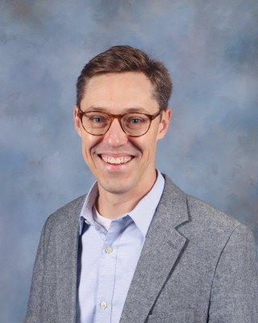
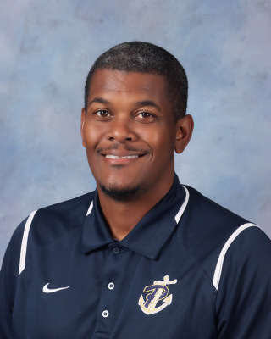
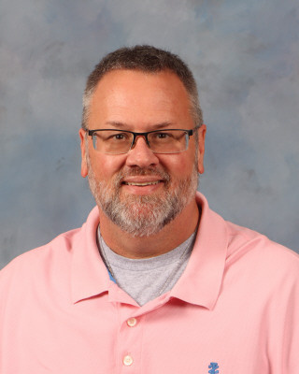
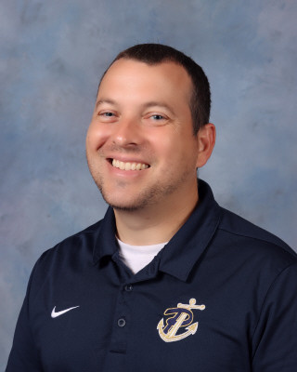
PJHS ADMINISTRATIVE STAFF
JOHN WALLACE
PRINCIPAL
TIM JACKSON
ASST. PRINCIPAL
CHRIS LEE
ASST. PRINCIPAL
DENNIS PHILEBAR
ASST. PRINCIPAL

Slide 5
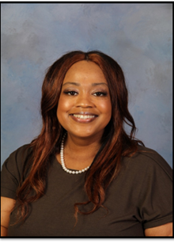
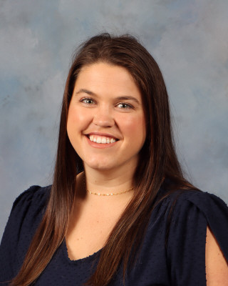
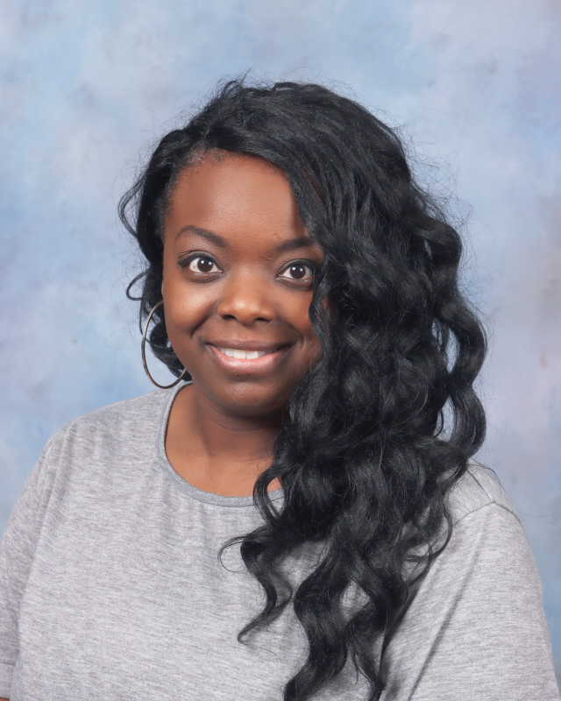
COUNSELORS
BRIGIT NELSON
JANA WATTS
CRYSTAL GRAY
6TH GRADE
BNELSON@PEARLK12.COM
7TH GRADE
JWATTS@PEARLK12.COM
8TH GRADE
CGRAY@PEARLK12.COM

Slide 6

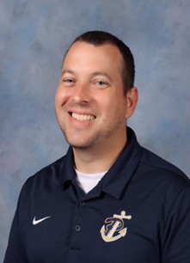
MR. PHILEBAR
MS. NELSON
6TH GRADE PRINCIPAL
6TH GRADE
SCHOOL COUNSELOR
DPHILEBAR@PEARLK12.COM
BNELSON@PEARLK12.COM
601-932-7969
601-933-2463

Slide 7
PJHS
EXPECTATIONS
PJHS
EXPECTATIONS

Slide 8


WE EXPECT OUR STUDENTS TO BE...
PREPARED
RESPECTFUL
INVOLVED
DEPENDABLE
EXCELLENT
BRING ALL MATERIALS AND ASSIGNMENTS
RESPECT SCHOOL PROPERTY
KEEP YOUR AREAS CLEAN
COMPLETE ASSIGNMENTS ON TIME
HELP EACH OTHER AND MAKE GOOD DECISIONS
WALK WITH A PURPOSE
USE GOOD MANNERS AND RESPECTFUL LANGUAGE
ACTIVELY PARTICIPATE IN DISCUSSIONS AND ACTIVITIES
ARRIVE TO CLASS ON TIME
ALWAYS DO YOUR BEST
BE ON TIME
ADHERE TO DRESS CODE
LISTEN AND FOLLOW STAFF DIRECTIONS
FOLLOW INSTRUCTIONS THE FIRST TIME
REPORT BULLYING AND MISBEHAVIOR
LIKE A PIRATE

Slide 9
ARRIVAL
DISMISSAL
    NO STUDENTS ARE ALLOWED ON CAMPUS PRIOR TO 7:45.
    ALL CAR RIDERS MUST BE DROPPED OFF IN THE BACK OF THE BUILDING VIA THE CAR RIDER LINE.
    NO DROP-OFFS IN THE FRONT OF THE SCHOOL!
    *SCHOOL RESOURCE OFFICER WILL MONITOR THIS.
    STUDENTS WILL EITHER REPORT DIRECTLY TO THE CAFE FOR BREAKFAST OR TO THEIR FIRST BLOCK CLASSROOM.
    ALL STUDENTS MUST LEAVE THE ROOM/BUILDING QUIETLY AND ON THE RIGHT SIDE OF THE HALLWAYS.
    THERE WILL BE NO LOITERING IN THE COURTYARD OR BUS LINE AT DISMISSAL.

Slide 10
CLASSROOM
CAFETERIA
    BRING ALL MATERIALS AND ASSIGNMENTS
    BE ON TIME AND SEATED WHEN THE BELL RINGS
    USE GOOD MANNERS AND RESPECTFUL LANGUAGE
    KEEP HANDS AND FEET TO SELF
    LISTEN AND FOLLOW DIRECTIONS
    ACTIVELY PARTICIPATE IN DISCUSSIONS AND ACTIVITIES
    COMPLETE ASSIGNMENTS ON TIME
    FOLLOW DIRECTIONS THE FIRST TIME
    ALWAYS DO YOUR BEST
    BRING MONEY FOR LUNCH
    PARENTS BE SURE TO FILL OUT LUNCH FORM EACH SCHOOL YEAR.
    KNOW LUNCH NUMBER AND ASSIGNED TABLE
    EAT ONLY ITEMS PURCHASED OR BROUGHT FROM HOME
    FORM A SINGLE FILE LINE
    PATIENTLY WAIT YOUR TURN IN LINE
    BE POLITE TO CAFETERIA STAFF
    SPEAK QUIETLY
    REMAIN SEATED
    CLEAN UP YOUR ENTIRE AREA
    KEEP ALL FOOD ON YOUR TRAY
    KEEP FOOD AND DRINK IN THE CAFE
    USE YOUR TIME WISELY
    TAKE PRIDE IN CLEANLINESS

Slide 11
HALLWAY
RESTROOM
    MOVE QUICKLY AND PROMPTLY TO ASSIGNED LOCATIONS
    LEAVE VALUABLES AT HOME
    SPEAK QUIETLY
    USE RESPECTFUL LANGUAGE AND APPROPRIATE VOICE LEVEL
    KEEP HANDS AND FEET TO SELF
    LISTEN AND FOLLOW STAFF DIRECTIONS
    KEEP AREA CLEAN
    TAKE ITEMS TO LOST AND FOUND
    ARRIVE TO CLASS ON TIME
    WALK ON THE RIGHT SIDE OF THE HALLWAY
    FOLLOW DRESS CODE
    REPORT SAFETY ISSUES/PROBLEMS
    HELP OTHERS IN NEED
    GO DURING ASSIGNED TIMES
    GIVE OTHERS PRIVACY
    RESPECT SCHOOL PROPERTY
    REFRAIN FROM HORSEPLAY
    KEEP RESTROOMS CLEAN
    FLUSH WHEN FINISHED
    WASH HANDS THOROUGHLY
    USE RESTROOM FOR APPROPRIATE REASONS
    RETURN TO CLASS PROMPTLY
    REPORT BULLYING, GRAFFITI, OR MISBEHAVIOR TO AN ADULT.
    LEAVE RESTROOM BETTER THAN YOU FOUND IT.

Slide 12

BUS
    BE AT BUS STOP ON TIME
    ENTER ORDERLY AND QUIETLY
    REMAIN SEATED IN ASSIGNED SEAT FACING FORWARD
    NO TALKING AT RAILROAD CROSSINGS
    FOLLOW DRIVER’S DIRECTIONS
    USE RESPECTFUL LANGUAGE AND APPROPRIATE VOICE LEVEL
    KEEP HANDS AND FEET TO SELF
    INFORM DRIVER OF MISCONDUCT
    CLEAN UP AROUND YOUR SEAT
    RETURN PERSONAL ITEMS LEFT ON BUS TO DRIVER
    FOLLOW BUS RULES
    HELP EACH OTHER MAKE GOOD DECISIONS

Slide 13

CELL PHONES
    POWERED OFF!
    PUT AWAY BETWEEN 7:40AM - 3:30PM
    IF A PHONE IS SEEN DURING THE DAY IT WILL BE CONFISCATED
    PARENTS CAN LEAVE A MESSAGE FOR THE STUDENT TO SEE WHEN THEY POWER THEIR PHONE ON
    STUDENTS CAN CALL HOME FROM THE MAIN OFFICE

Slide 14

ATTENDANCE

Slide 15

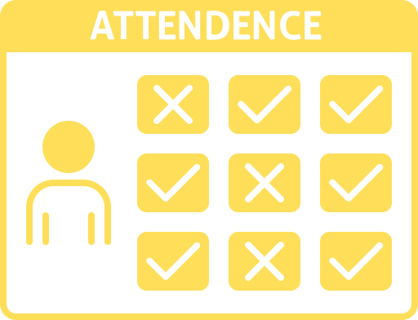
ATTENDANCE
1
DAILY ATTENDANCE IS CRITICAL FOR ACADEMIC SUCCESS!
2
ATTENDANCE IS SEPARATE FOR EACH CLASS.
3
BLOCK SCHEDULE - 1 ABSENCE IS THE SAME AS MISSING 2 CLASSES.
4
ONLY 2 DAYS TO TURN IN AN EXCUSE.
5
IT IS THE CHILD'S RESPONSIBILITY TO MAKE UP WORK WHEN THEY RETURN FROM THE ABSENCE.

Slide 16
THE
TRANSITION TO
JUNIOR HIGH SCHOOL

Slide 17



STAY INFORMED...
CANVAS
ACTIVE
PARENT
SCHOOL
STATUS
KEEP UP WITH WHAT IS GOING ON IN EACH CLASS!
KEEP UP WITH GRADES, ABSENCES, AND DISCIPLINE
SAVE THE NUMBER AS CLASS/TEACHER THE FIRST TIME A MESSAGE IS SENT.

Slide 18

SCHOOL DAY SCHEDULE
A - DAY
B - DAY
WEDNESDAY
9:00 ALL BAND STUDENTS WILL SPLIT WITH CYBER FOUNDATIONS EVERYDAY
8:53 ALL BAND STUDENTS WILL SPLIT WITH CYBER FOUNDATIONS EVERYDAY
1/5 - 8:15 - 9:43
1/5 - 8:15 - 9:36
2/6 - 9:47 - 11:23
2/6 - 9:40 - 11:09
LUNCH BLOCK - TIME VARIES BASED ON TEACHER
LUNCH BLOCK - TIME VARIES BASED ON TEACHER
3/7 - 11:27 - 1:32
3/7 - 11:13 - 1:09
4/8 - 1:36 - 3:14
4/8 - 1:13 - 2:44
6TH GRADE WILL DISMISS FIRST
6TH GRADE WILL DISMISS FIRST

Slide 19


BRING YOUR SCHEDULE EVERY DAY
SCHEDULES
MATH & ENGLISH EVERY DAY
SCIENCE EVERY OTHER DAY
SOCIAL STUDIES EVERY OTHER DAY
BAND STUDENTS WILL GO TO BAND AND CYBER FOUNDATIONS EVERY DAY

Slide 20
    6TH GRADE IS A HARD TRANSITION YEAR
    WE GIVE VERY LITTLE HOMEWORK
    BEING AT SCHOOL EVERY DAY IS VITAL
    WE DO NOT SEND HOME NEWSLETTERS
    WE TEACH RESPONSIBILITY AND ACCOUNTABILITY
    PARENTAL INVOLVEMENT IS CRUCIAL
IMPORTANT INFORMATION

Slide 21
    THRIVING IN JUNIOR HIGH SCHOOL IS A TEAM EFFORT! PARENTS PLAY THE MOST IMPORTANT ROLE.
    PUNISHMENT ALONE USUALLY CANNOT “FIX” THE STUDENT WHO IS OFF TRACK OR STRUGGLING. THEY NEED HELP AND ADEQUATE TRAINING IN SELF-DISCIPLINE. THIS REQUIRES HEAVY PARENTAL INVOLVEMENT.
    WE SEE YOUR CHILD 7 HOURS A DAY, SO PLEASE INFORM US OF IMPORTANT THINGS THAT WE CAN HELP MONITOR, SUCH AS A DIFFICULT EMOTIONAL TIME, SO THAT WE CAN BE AWARE/SENSITIVE AND COMMUNICATE WITH YOU.
MONITORING AND MOLDING NEW HABITS

Slide 22
Clubs
&
organizations

Slide 23

CLUBS
STUDENT
COUNCIL
SHIPMATES
FCA
BETA
CLUB
TECHNOLOGY
STUDENT
ASSOCIATION
FCA FOCUSES ON SERVING LOCAL COMMUNITIES AROUND THE GLOBE BY ENGAGING, EQUIPPING AND EMPOWERING EVERYONE TO UNITE, INSPIRE AND CHANGE THE WORLD.
BETA IS COMMITTED TO RECOGNIZING HIGH ACADEMIC ACHIEVEMENT, NURTURING WORTHY CHARACTER, FOSTERING LEADERSHIP SKILLS AND ENCOURAGING SERVICE TO OTHERS.
THE TECHNOLOGY STUDENT ASSOCIATION ENHANCES PERSONAL DEVELOPMENT, LEADERSHIP, AND CAREER OPPORTUNITIES IN STEM, WHEREBY MEMBERS APPLY AND INTEGRATE THESE CONCEPTS THROUGH INTRACURRICULAR ACTIVITIES, COMPETITIONS, AND RELATED PROGRAMS.
ENCOURAGE PERSONAL GROWTH OF LEADERS THROUGH PARTICIPATION, SERVICE PROJECTS, AND OTHER VARIOUS OPPORTUNITIES.
A CLUB TO HELP BRING AWARENESS TO BULLYING AND PROMOTING A SAFE SCHOOL ENVIRONMENT AND KINDNESS TO EVERYONE.

Slide 24
ELECTIVE OPTIONS

Slide 25

ART
BAND
CHOIR
CYBER FOUNDATIONS
STUDENTS WILL LEARN ABOUT FAMOUS ARTISTS, THE ELEMENTS AND PRINCIPLES OF ART, AND HOW TO MIX COLORS WITH PAINT, AND COMPOSE ORIGINAL WORKS OF ART.
STUDENTS WILL LEARN ABOUT MUSIC THEORY AND ALL THE INSTRUMENTS IN THE BAND. STUDENTS WILL BECOME PROFICIENT WITH THEIR INSTRUMENTS.
SINGERS WILL BE INTRODUCED TO THE CONCEPTS OF CHORAL TONE, SIGH-READING, AND PERFORMANCE.
FOCUSES ON THE AREAS OF TECHNOLOGY LITERACY, WORKFORCE, AND ACADEMIC SKILLS NECESSARY TO COMPETE IN A GLOBAL WORKFORCE.
ELECTIVES
INTRO TO ATHLETICS
QUEST
ROBOTICS
THEATRE
STUDENTS WILL LEARN THE FIELD OF ROBOTICS AND STIMULATE THEIR INTERESTS IN SCIENCE AND ENGINEERING.
STUDENTS WILL BE ENCOURAGED AND STIMULATED TO EXPLORE THEIR INTELLECTUAL AND CREATIVE ABILITIES THROUGH LEARNING AND PRACTICING BASIC CONCEPTS OF THEATER.
STUDENTS WILL BE INTRODUCED TO A VARIETY OF TEAM SPORTS IN AN INTRAMURAL PHYSICAL EDUCATION SETTING.
AVAILABLE ONLY TO STUDENTS WHO HAVE AN ELIGIBLE GIFTED RULING.

Slide 26
COURSE SELECTIONS
&
REQUIREMENTS

Slide 27
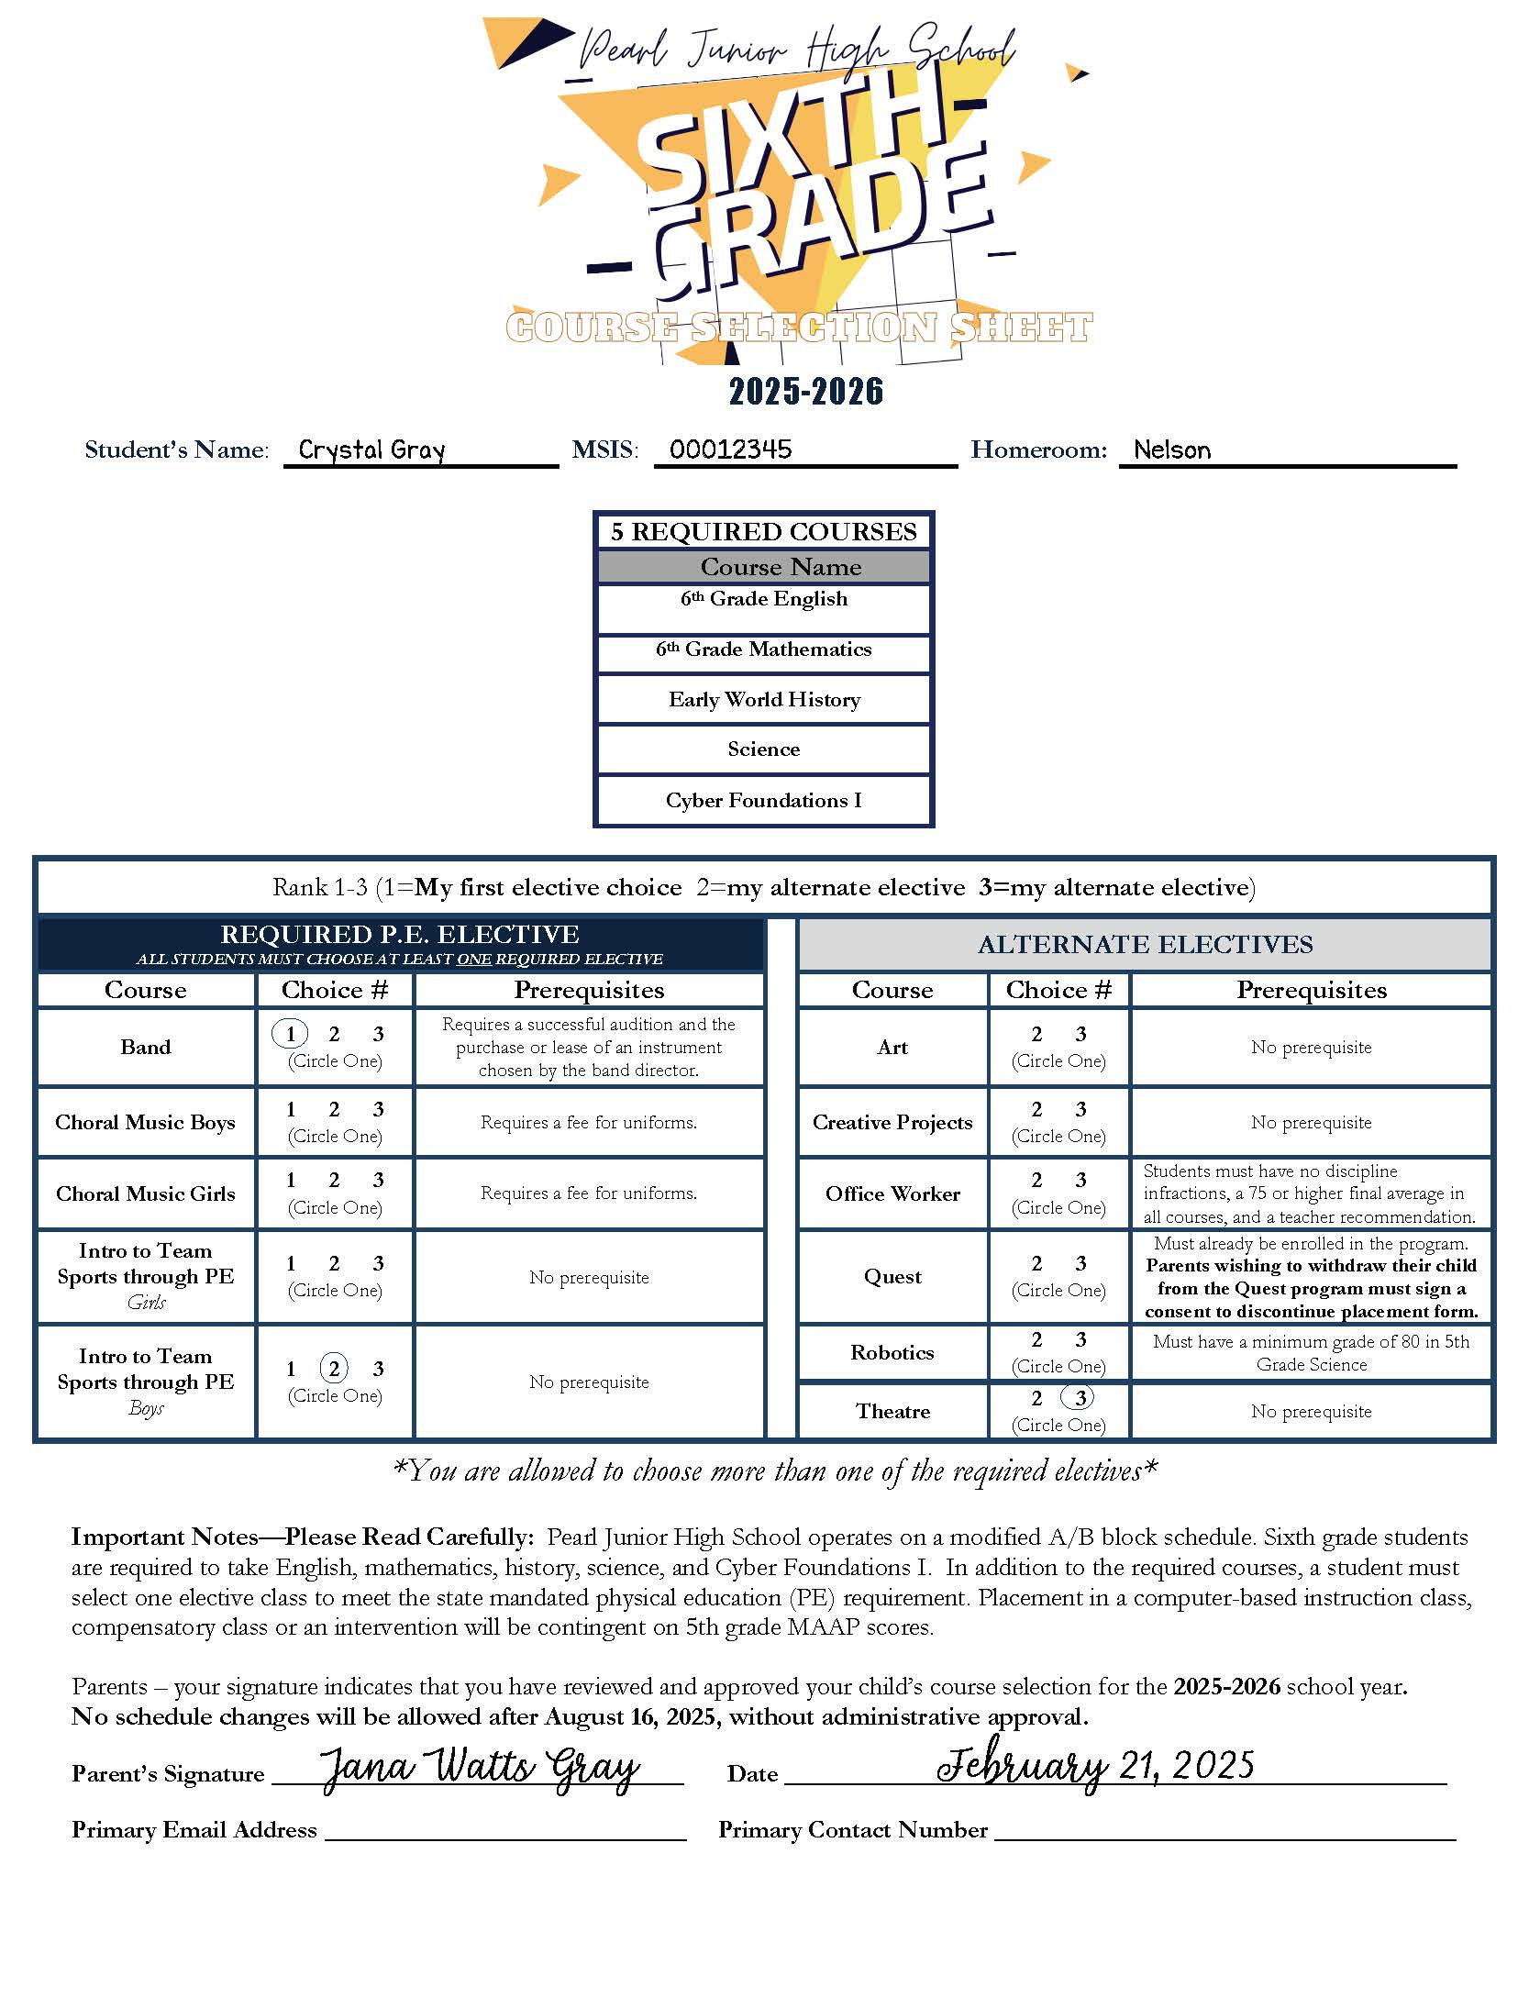
REQUIRED COURSES

Slide 28
HOW TO COMPLETE CHOICE SHEET

Slide 29
1. Pick 3 elective classes.
  This is in case you don't get your top 2 choices.
2. Your #1 choice must be a P.E. elective
  Circle a 1 by your favorite (must be a Required P.E. course).
  Circle a 2 by your second choice.
  Circle a 3 by your third choice.
MUST CHOOSE ONE

Slide 30
6TH GRADE COURSE SELECTION FORM
STUDENTS CAN FIND REQUIRED PREREQUISITES AND CHOICE SELECTIONS ON THE FORM. FORMS MUST BE SIGNED BY PARENT!
EMAIL
BNELSON@PEARLK12.COM
WITH ANY QUESTIONS
**IF CHOICE SHEETS ARE NOT RETURNED BY THE DUE DATE, YOUR ELECTIVES WILL BE CHOSEN FOR YOU!**

Slide 31
PARENT SIGNATURE REQUIRED
JWG@email.com
601-123-4567

Slide 32
IMPORTANT REMINDERS

Slide 33
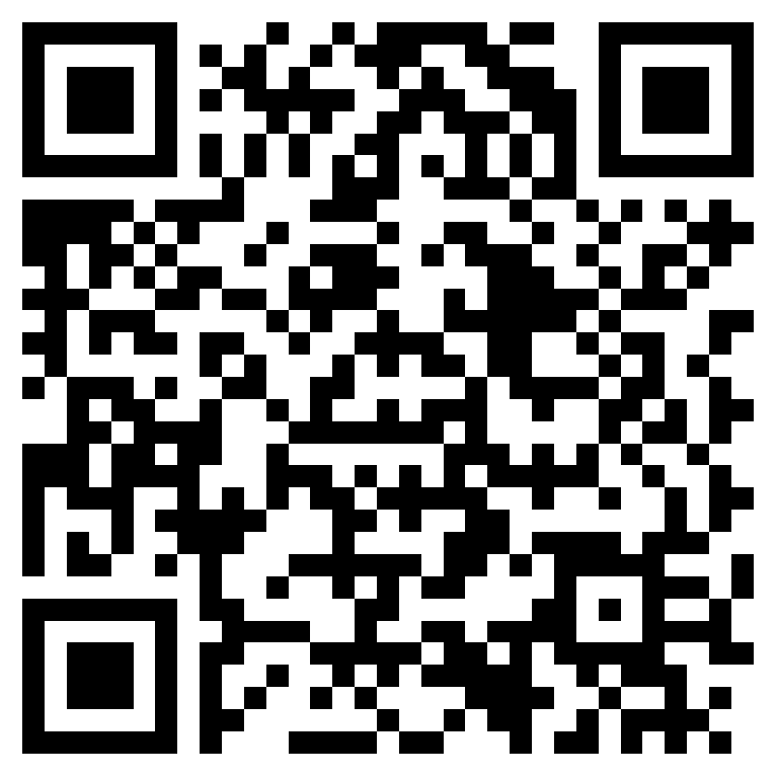
Scan the QR to apply:
OFFICE WORKER APPLICATION
Or click on the link below:
https://forms.office.com/r/yfmUjHkucz

Slide 34

CHOICE SHEETS ARE DUE BACK TO YOUR HOMEROOM TEACHERS ON

Slide 35
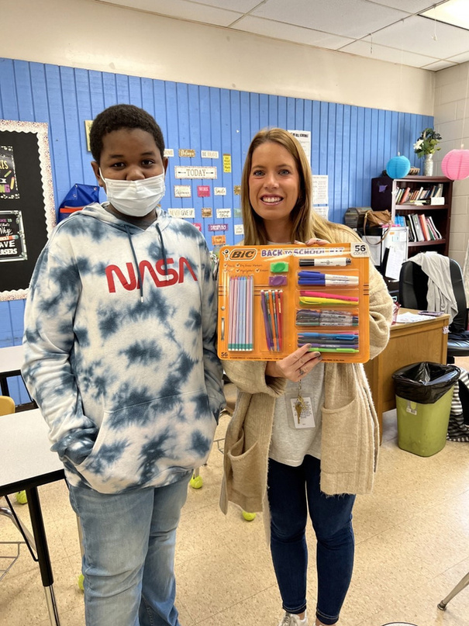
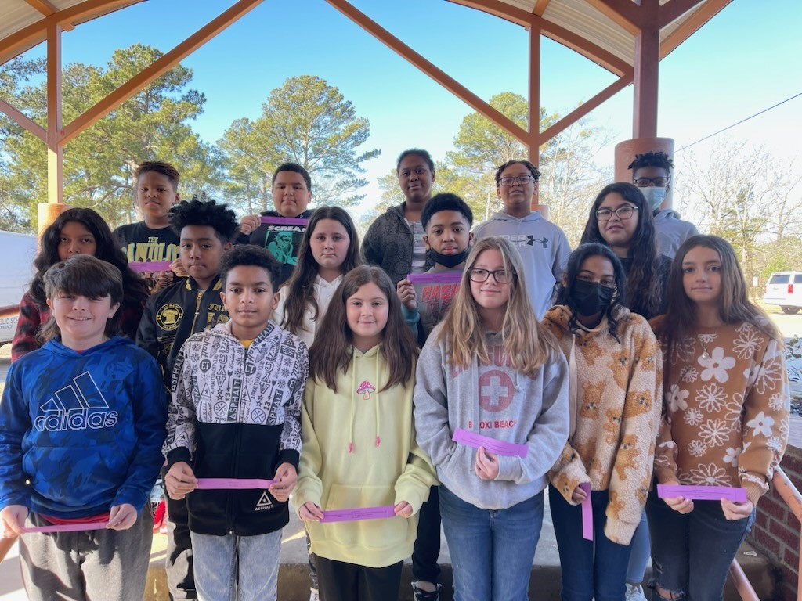

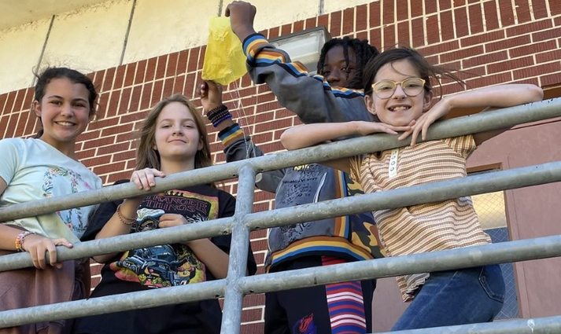
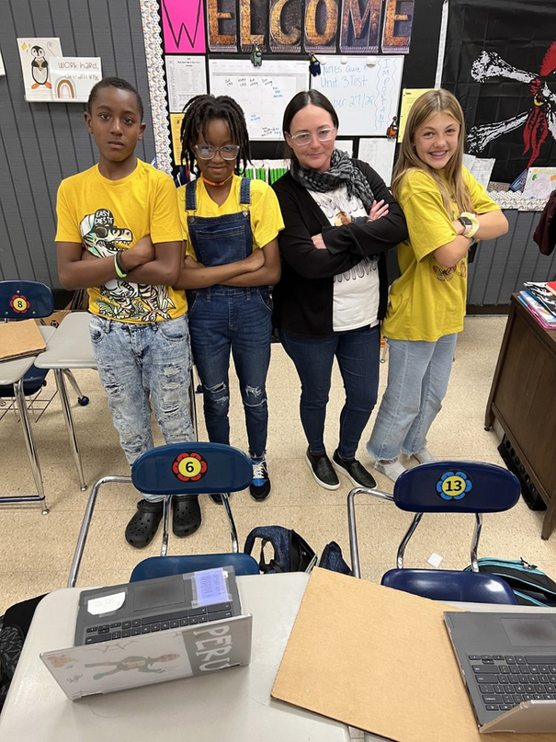
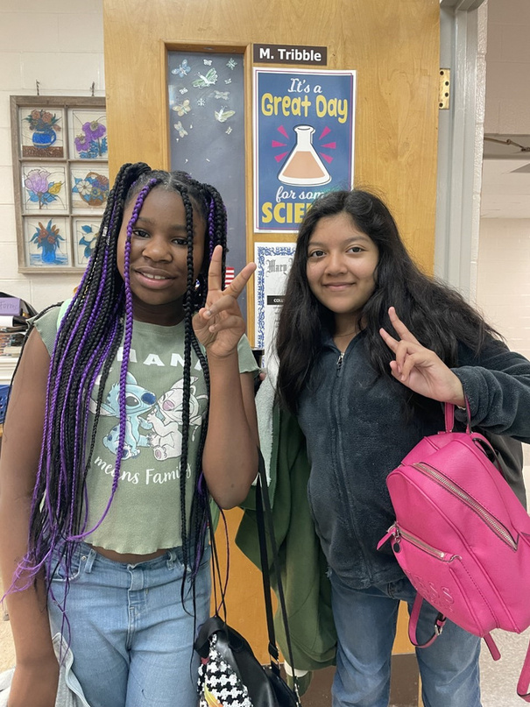
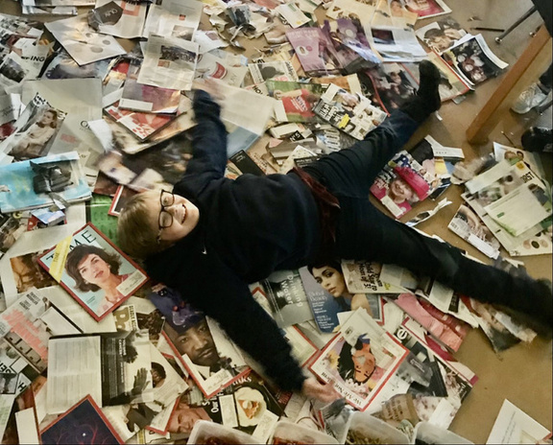
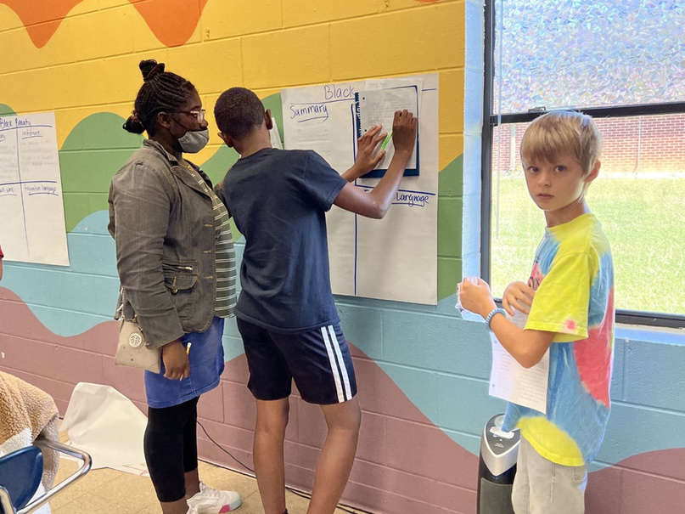
6TH GRADE

Slide 36

QUESTIONS?

